Slide 1
Establishing and Operating an Emergency Operations Center to Support the COVID-19 Response

Slide 2
Objectives
This presentation is intended to:
Describe the purpose of an EOC
Provide suggestions for how an EOC can support the COVID-19 response
List the possible components and design of an EOC

Slide 3
What is an EOC?
The physical location at which the coordination of information and resources to support incident management activities normally takes place.

Slide 4
Why have an EOC?
To support decision-makers in the accomplishment of their tasks
To provide the capability to receive, analyze, display, and monitor information
To be able to identify, organize, deploy, and track resources
To be able to communicate, collaborate, and coordinate from a centralized location
These actions are all critical for effective COVID-19 response.

Slide 5
Why have an EOC?
For the COVID-19 response, EOCs can:
Track and analyze epidemiological data from multiple sources, i.e. laboratory results, information for monitoring contacts, hospital admissions data, etc.
Monitor and track resource allocations, including testing kits, PPE, and personnel
Provide centralized and coordinated operational and public risk messaging

Slide 6
What does an EOC do?
Responsible for the strategic or operational overview of the response
Normally does not directly control field assets
Common functions include:
Collect and analyze information collection
make decisions that protect life and property
maintain continuity of the organization
disseminate decisions to all concerned agencies and individuals
In most EOCs there is one individual in charge, and that is the Emergency Manager

Slide 7
EOC Organizational Principles
Provides a management structure that results in better decisions and more effective use of available resources
Designed for incidents and responses that may involve multiple agencies and political jurisdictions.
Should be modular – able to expand or contract as incident grows or ends
These attributes are critical for the dynamic, politicized, and high impact nature of the COVID-19 response.

Slide 8
EOC Organizational Principles
One globally recognized management system is known as the Incident Management System (IMS)
Basic structure:
Leadership (Emergency or Incident Manager)
Four sections: Planning, Operations, Logistics, and Finance/Administration
Management staff: Safety Officer, Liaison Officer (also called Partner Engagement Officer), Public Information Officer

Slide 9
Basic IMS Structure
Incident/Emergency Manager
Management Staff
Planning
Operations
Logistics
Finance/
Admin

Slide 10
IMS Structure *can be scaled up as needed*

Slide 11
IMS Structure
Benefits of IMS:
Provides standardized organizational structures, functions, processes and terminology for use at all levels of emergency response, including with external partners
Provides a standardized way to manage objectives and organize participating agencies
Supports the exchange of information among key participants to carry out a unified response for an emergency
Can be used in small or large situations: scalable and modular

Slide 12
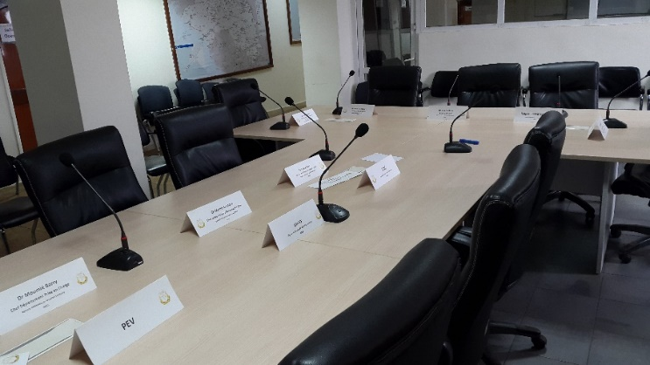
Developing an EOC
The development process should include:
Prioritization (COVID-19 versus longer-term development)
Mission
Communications Process
Operational Approach
Organization Design and Structure
Response Reporting
Facility Design Considerations
August, 2017, National Public Health EOC in Conakry, Guinea, immediately before weekly briefing
(Photo: Claire Standley)

Slide 13
Prioritization
Define immediate priorities for supporting COVID-19 response
Identify timeline for reviewing and updating EOC mission and authorities for longer-term development

Slide 14
Define the EOC’s Mission
Mission analysis:
What will the EOC do?
What functions will the EOC perform?
How will the EOC be staffed?
Under what conditions will the EOC operate?
Initial emphasis on COVID-19 response

Slide 15
Define the EOC’s Mission
Review documentation to identify responsibilities:
Regulations
Legislation
Laws and Codes
Directives
Memorandums
Standard Operating Procedures

Slide 16
Communications
Who will the EOC communicate with?
Identify all relevant COVID-19 partners
What will be communicated to or by the EOC?
Notifications, warnings, reports, data
How often will communications occur?
Daily (for sitreps), immediately (alerts), etc.
What is the standard process for communicating with stakeholders?
Telephone, email, WhatsApp – locally defined
Are there alternate/redundant systems?

Slide 17
Operational Approach
Do you have 24 hour a day/7 days a week operation or a “business hours” operation?
Will you have a telephone answering service?
How do you want to operate?
A representative for each region or organization within the Ministry?

Slide 18
Organizational Design
Driven by:
Roles and responsibilities of staff
Skill and knowledge of personnel
Number of personnel

Slide 19

Response Reporting
Event-specific:
Situation reports (SITREP)
Shift change reports
Incident Action Planning (IAP)
Spot reports (less detailed than SITREP, may focus on one operational site)
National or regionally-specific epidemiological networks or reporting frameworks

Slide 20
Facility Design Considerations
Location
Size
Layout
Facility Use
Technology
Threats/ Vulnerabilities
Costs (i.e. rent)

Slide 21
Location
When choosing a location consider:
How close is it to collaborative organizations?
Is it available for use?
Are there regulatory restrictions?
Are there existing structures that are compatible?
What is the infrastructure support like?
Timeline: temporary for COVID-19 response or more permanent facility?

Slide 22
Size
Size will depend on the staff requirements to accomplish the pre-defined mission
Ideal size would have sufficient space to hold all the personnel required to respond to a full-scale incident
How many personnel are being used for COVID-19 response?
Layout of the EOC should be tailored to meet organizational design requirements

Slide 23
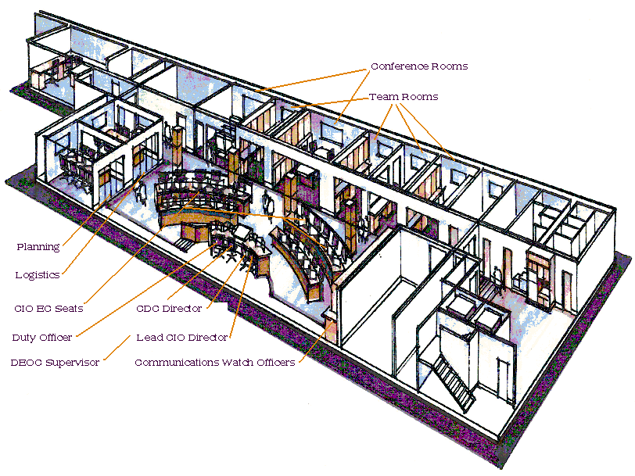
Layout
Communication and eye contact between decision makers
Space for:
Operational Coordination
Decision Making
Collaboration
Communications

Slide 24
Facility Use
Will the EOC be dedicated space, available at any time and for any length of time needed?
Will it be used beyond the COVID-19 response?
Will the facility be for response use only?
Will personnel work in the EOC daily?
Will training be conducted in the EOC?
If space is shared, consider:
How long will it take to transition?
Who will maintain readiness of equipment?
What happens to the displaced persons?

Slide 25
Technology
EOC
Telephones
&
Cellular
Satellite
Systems
Tablets
Radio
Internet
Video
Display
Video
Tele-
conference
Audio
Bridge
Line (Telecon)
Television
What technologies are available and can be implemented to enhance EOC performance?

Slide 26
Threats and Vulnerabilities
Should be eliminated, minimized, mitigated, and planned for to keep staff safe:
Power disruption
Physical attack
Fire
Telecommunications disruption
Environmental factors (heating and cooling)
Severe Weather/Natural Disasters
Flooding
Earthquakes

Slide 27
Final Thoughts
The importance of an IMS or similar response structure for internal organizational use and coordination with external partners cannot be overemphasized
Flexibility and adaptation of the response structure and operations are critical for continuous improvement
Advance preparation, including training new personnel and conducting exercises, ensures much more effective and efficient response when an emergency occurs
However, even “just in time” establishment of an IMS structure and/or EOC can be beneficial during emergencies like COVID-19

